Slide 1
Songs Analysis
Using PowerBI
A project under Mentorness internship

Slide 2
Project Objectives:
Conduct a comprehensive analysis of YouTube songs data using Power BI
Provide insights into performance, popularity, and user engagement
Aid content creators and stakeholders in optimizing YouTube song content
Dataset Description:
Attributes include video ID, channel title, title, description, tags, published date, view count, like count, favorite count, comment count, video duration, video definition, and caption details

Slide 3
Data Cleaning and Preparation
Steps Taken:
Loaded dataset into Power BI
Converted published date and time to DateTime format
Converted video duration to seconds
Data Types and Conversions:
Published Date: Date/Time
Duration: Converted ISO 8601 format to seconds

Slide 4
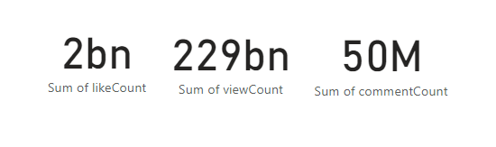
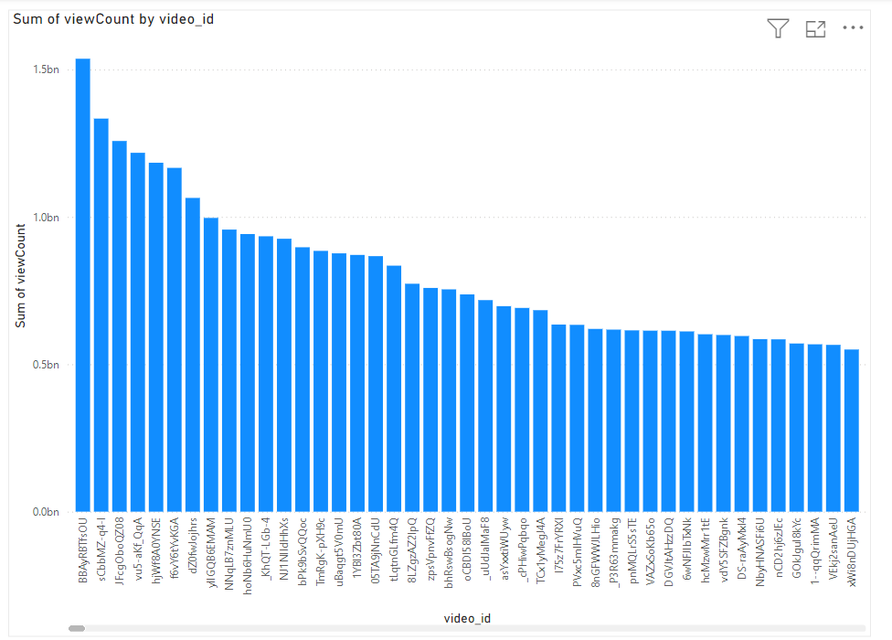
Exploratory Data Analysis (EDA)
Total comments, likes and views
Distribution of View Counts, Likes, and Comments:
Created bar chart to visualize distributions
- Analyzed the spread and central tendencies of key metrics

Slide 5
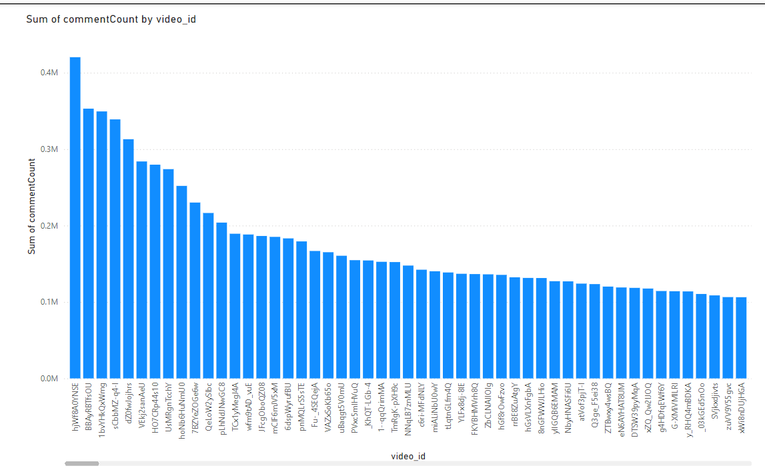

Slide 6
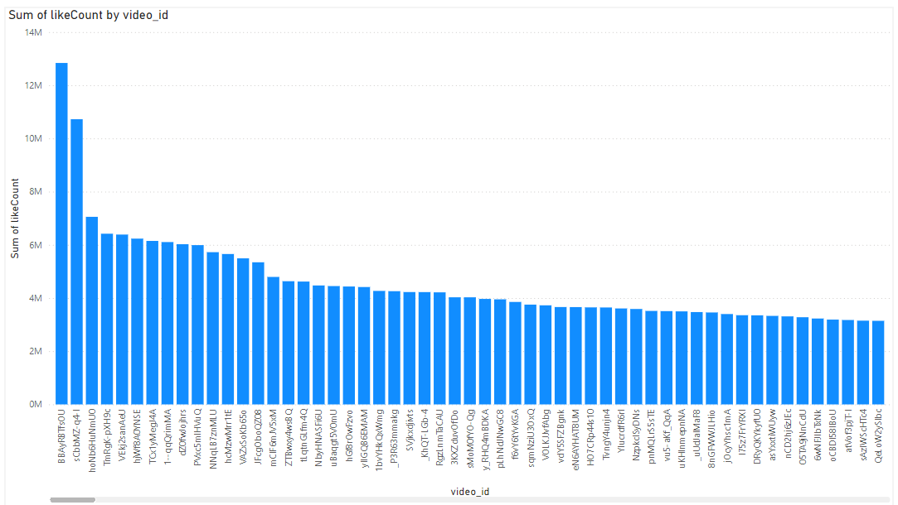

Slide 7
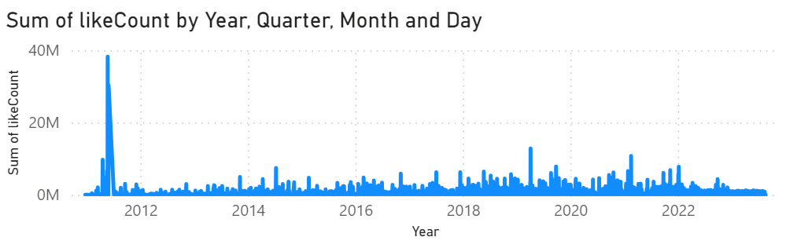
Trends in Popularity and Engagement:
Created line charts to identify trends over time
Analyzed how view counts, like counts, and comment counts change over time

Slide 8
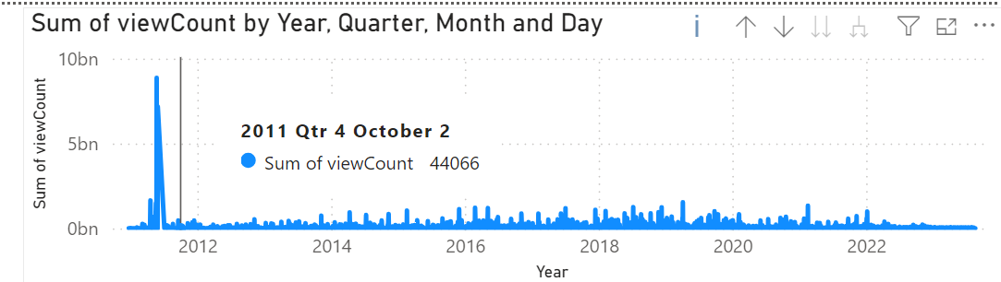
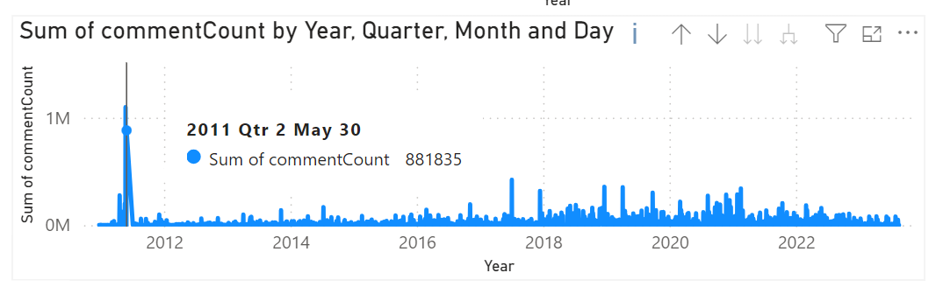

Slide 9
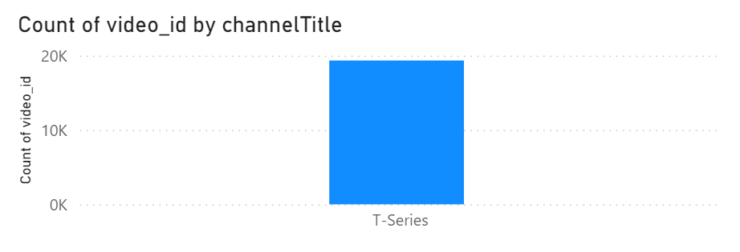
Content and Channel Analysis
Distribution of Videos Across Channels:
- Created bar charts to show the number of videos per channel
- Analyzed the spread of content across different channels

Slide 10
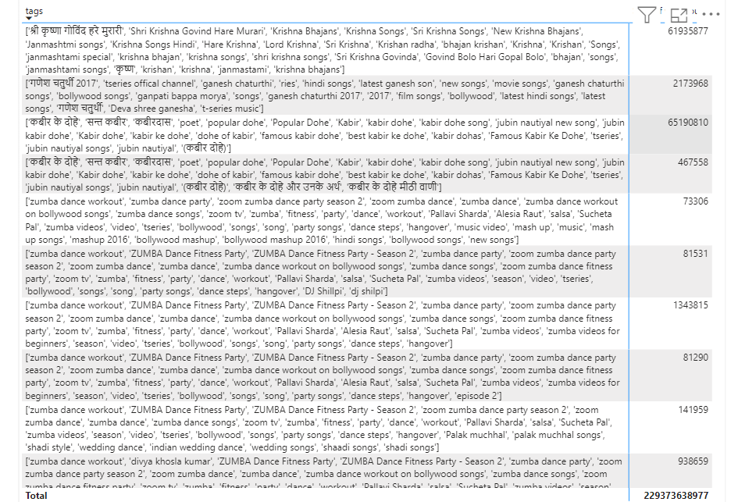
Popular Tags and Their Correlation with View Counts:
Created tables and scatter plots to display tags and associated view counts
Analyzed the correlation between tags and view counts

Slide 11
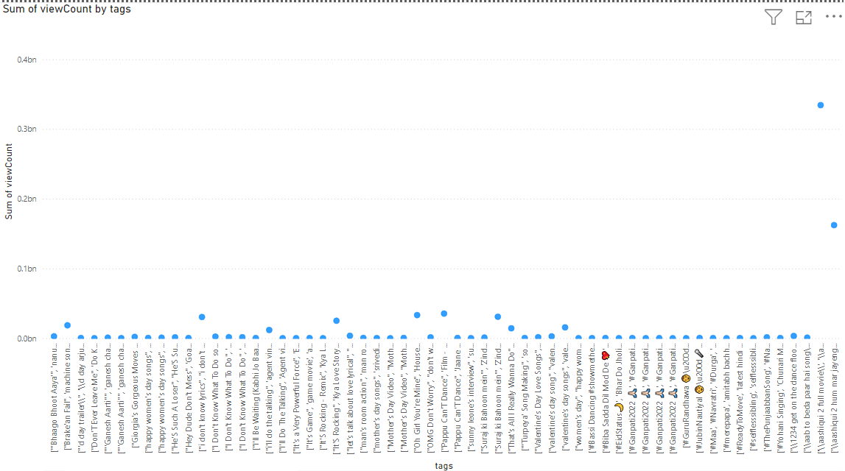

Slide 12
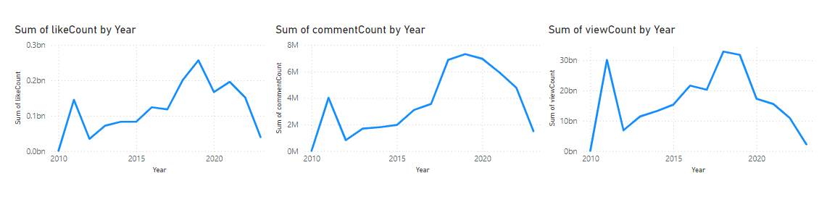
Temporal Trends
Metrics Over Time:
- Created line charts to explore how metrics vary over time
- Analyzed trends in view counts, like counts, and comment counts

Slide 13
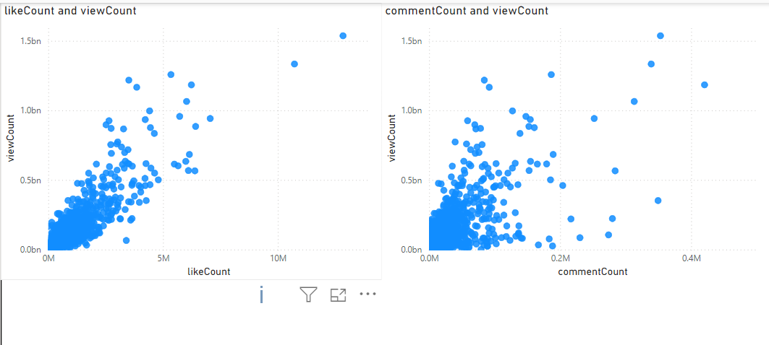
User Engagement Insights:
Relationships Between Likes, Comments, and Views:
- Created scatter plots to investigate relationships
- Analyzed how likes, comments, and views correlate with each other

Slide 14
The End
Thank You
Hasan Ayaz

